Slide 1


ContosoSales Analysis

Slide 2
Data Cleaning
Net Profit Column
Net profit Margin Column
Return Rate Column
SalesRevenue - ReturnAmount
SalesRevenue -TotalCost-(ReturnAmount / SalesRevenue)
ReturnAmount/ SalesRevenue
VLOOKUP is used in this Dataset to combine our Tables together

Slide 3

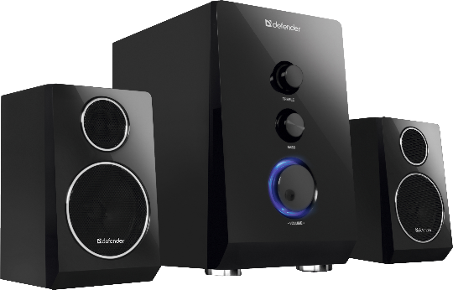
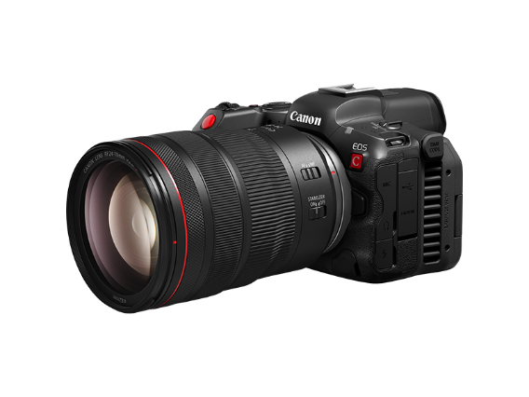
We specialize in selling
Media and Electronic Devices
We Have 6 Categories
TV and Video
Music, Movies and Audio Books
Computers
Cell phones
Cameras and camcorders
Audio

Slide 4

We Have 10 Brands that supplies these categories
Wide World Importers
The Phone Company
Southridge Video
Proseware
Northwind Traders
Litware
Fabrikam
Contoso
Adventure Works
A. Datum

Slide 5
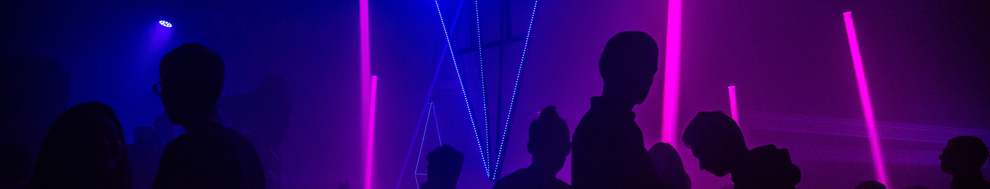
Some Statistics About the Sales
2007
2008
2009
38%
32%
30%
DESCRIPTION
DESCRIPTION
DESCRIPTION
We achieved the highest Sales in that year
There was a Global financial crisis and that caused a huge drop in our sales
The sales was nearly the same as we started to recover

Slide 6
Total Sales Per Category
Highest sales are the computers
The lowest Sales are the Audio

Slide 7
Total Sales Per Brand
The Highest Brand sales are the Fabrikam
The lowest Brand Sales are the NorthWind traders

Slide 8
Sales Per SubCategory
The Highest sales are the Camcorders
The lowest Sales are the VCD & DVD

Slide 9
Top 10 Product Sales
Proseware Projector 1080p LCD86 White | $955M
Proseware Projector 1080p DLP86 Silver | $829M
Contoso Projector 1080p X980 White | $791M
Proseware Projector 1080p LCD86 Black | $790M
Contoso Projector 1080p X980 Black | $761M
Contoso Projector 1080p X980 Silver | $754M
Proseware Projector 1080p DLP86 Black | $605M
Adventure Works Desktop PC1.80 ED182 White | $572M
Proseware Projector 1080p LCD86 Silver | $564M
Proseware Projector 1080p DLP86 White | $557M

Slide 10
Most Return Product
Contoso Projector 1080p X980 White | $16,065
Proseware Projector 1080p DLP86 Silver | $14,994
Proseware Projector 1080p DLP86 Black | $12,495
Contoso Projector 1080p X980 Silver | $9,180
Adventure Works Laptop19W X1980 Blue | $9,093
Adventure Works 52" LCD HDTV X790W Black | $7,961
Fabrikam Laptop19 M9000 Black | $7,693
Adventure Works 42" LCD HDTV M55 Black | $7,635
Contoso Home Theater System 7.1 Channel M1700 White | $7,112
Contoso Projector 720p M621 White | $6,993

Slide 11
Our Dashboard

Slide 12
Forecasting Model
We Expressed the past 3 Years as Quarters and this is the Revenue Across the 3 Years

Slide 13
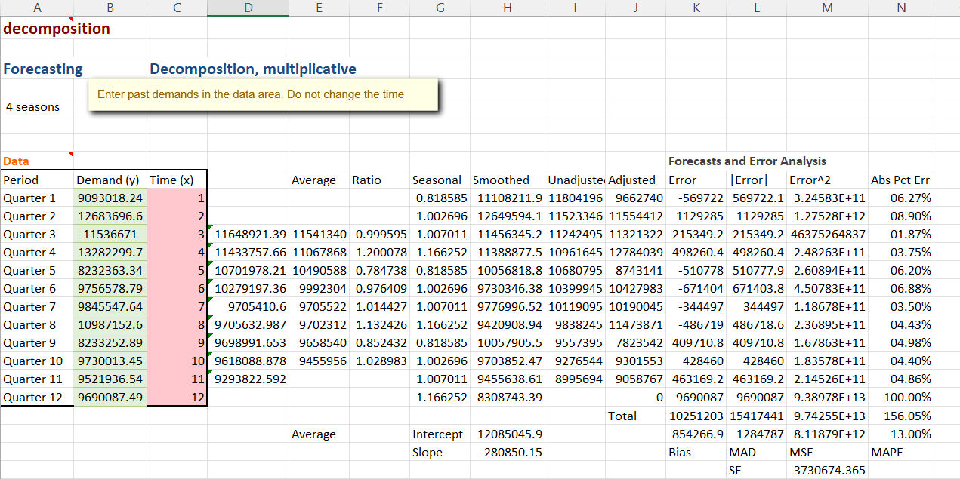
Decompision Model

Slide 14
Forecasting Model
We Found a Trend in Revenue in these 3 years

Slide 15
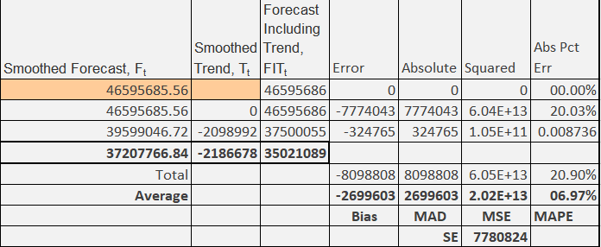
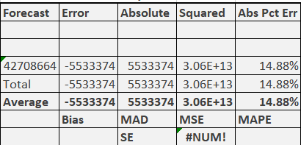
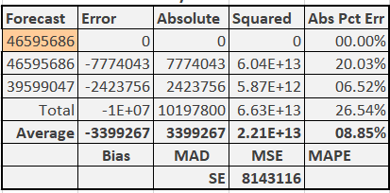
We Made 3 Models
Moving Average Error: 14.8%
Exponential Smoothing Error: 8.8%
Trend Smoothing Error: 7%
( The Best One )
2010 forecasted Revenue
37,207,766$

Slide 16

THANK YOU
HAVE A GREAT DAY

